Slide 1
COSC 2430
Lab 10/21/2019

Slide 2
Book Exercise
Goodrich, M. T., Tamassia, R., Goldwasser, M. H. Data Structures and Algorithms in Java. Wiley, 6th edition, 2016

Slide 3
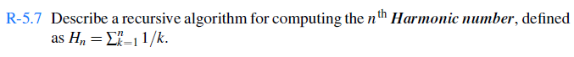
Chapter 5: Recursion
The recursive equation: H(n) = H(n-1) + 1/n
Double Harmonic_num(int n)
{
If (n==1)
Return 1;
Return Harmonic_num(n-1) + 1/n
}

Slide 4
Chapter 5: Recursion
R-5.8 Describe a recursive algorithm for converting a string of digits into the integer it represents. For example, '13531' represents the integer 13,531.
Let s’ = sd for digit d. We have that
Value(s’) = d+ 10 * Value(s)
//n: size of string
Int Convert(string s, int n)
{
if (n==1)
return Integer.parseInt(s);
else
{
d = Integer.parseInt(s[n-1] );
return d + 10*convert(s,n-1)
}

Slide 5
Chapter 5: Recursion
R-5.10 Describe a way to use recursion to compute the sum of all the elements in an n×n (two-dimensional) array of integers.
Lest look at one dimensional array:
public static int binaryRecursiveSum( int[] data, int low, int high )
{
if( low>high )
return 0;
else if( low == high )
return data[low];
else
{
int mid = (low+high)/2;
return binaryRecursiveSum(data, low, mid)+binaryRecursiveSum(data, mid+1, high);
}
}

Slide 6
Chapter 5: Recursion
R-5.10 Describe a way to use recursion to compute the sum of all the elements in an n×n (two-dimensional) array of integers.
Now for two dimensional array:
public static int binaryRecursiveSum( int[] data, int xlow, int xhigh, int ylow, int yhigh )
{
if( xlow>xhigh )
return 0;
else if( xlow == xhigh and ylow==yhigh)
return data[xlow][ylow];
else
{
int xmid= (xlow+xhigh)/2;
int ymid = (ylow+yhigh)/2;
return binaryRecursiveSum(data, xlow, xmid, ylow, ymid)+
binaryRecursiveSum(data, xmid+1, xhigh, ylow, ymid,)+
binaryRecursiveSum(data, xlow, xmid, ymid+1, yhigh)+
binaryRecursiveSum(data, xmid+1, xhigh, ymid+1, yhigh);
}
}

Slide 7
Chapter 5: Recursion
C-5.20 Write a short recursive Java method that rearranges an array of integer values so that all the even values appear before all the odd values.

Slide 8
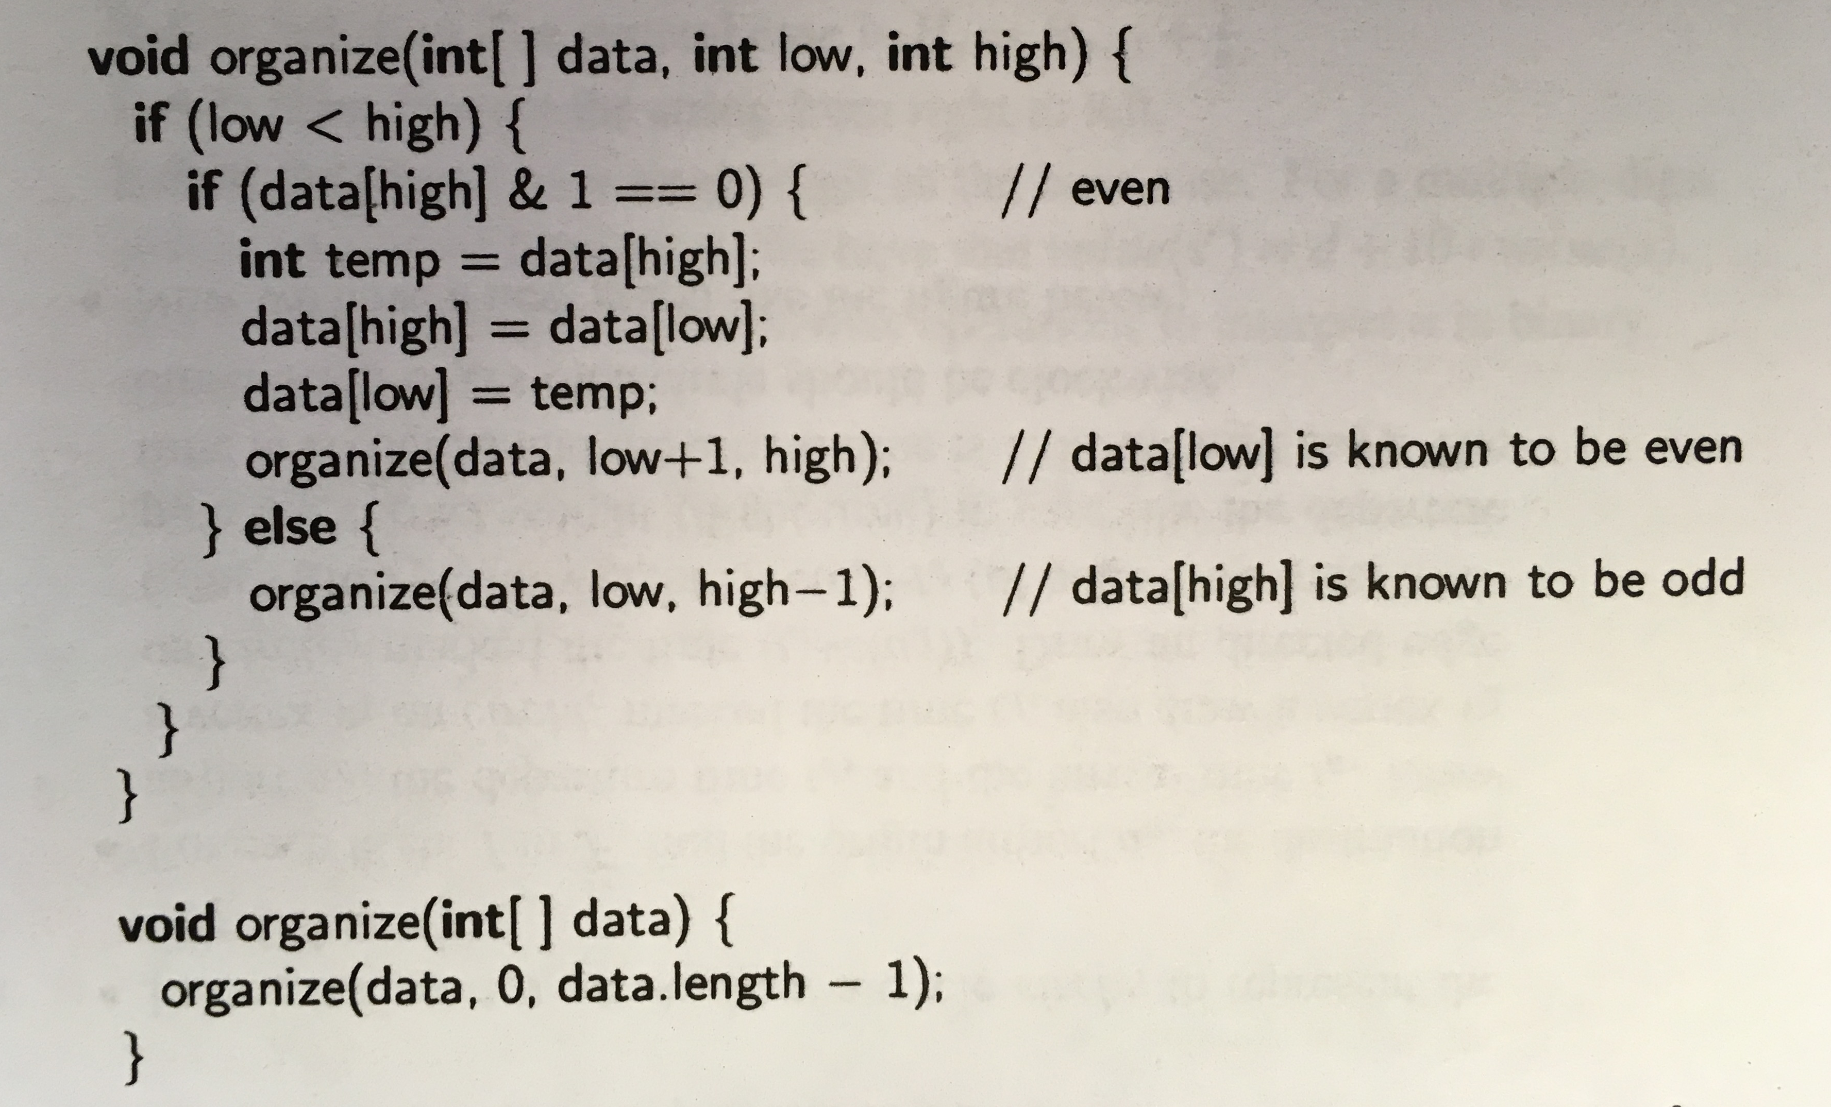
Chapter 5: Recursion
& : Bitwise AND
5= 0101
1= 0001
5 & 1 = 0001 => 5 is odd
4= 0100
1= 0001
4 & 1 = 0000 => 4 is even

Slide 9
Chapter 6: Stacks, Queues, and Deques
R-6.1 Suppose an initially empty stack S has performed a total of 25 push operations, 12 top operations, and 10 pop operations, 3 of which returned null to indicate an empty stack. What is the current size of S?
If stack is empty when pop is called, its size does not change!
Top does not change the size of stack; it only returns the top of stack without modifying it.
The size is 25 (push) -10 (pop) + 3 (empty pop) = 18.

Slide 10
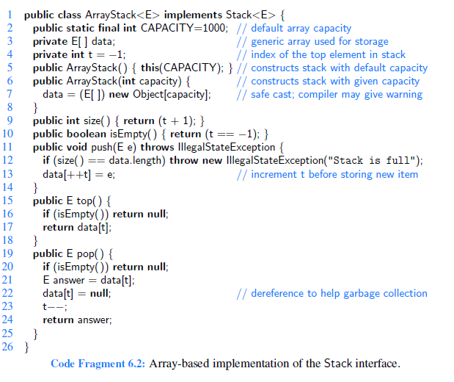
Chapter 6: Stacks, Queues, and Deques
R-6.2 Had the stack of the previous problem been an instance of the ArrayStack class, from Code Fragment 6.2, what would be the final value of the instance variable t?
T= 24 (for 25 push) – 10 (pop) + 3 (empty)= 17

Slide 11
Chapter 6: stacks, Queues, and Deques
R-6.3 What values are returned during the following series of stack operations, if executed upon an initially empty stack? push(5), push(3), pop(), push(2), push(8), pop(), pop(), push(9), push(1), pop(), push(7), push(6), pop(), pop(), push(4), pop(), pop().
3,8,2,1,6,7,4,9

Slide 12
Chapter 6: Stacks, Queues, and Deques
R-6.5 Give a recursive method for removing all the elements from a stack.
public void rec_remove(Stack<E> S)
{
if s.IsEmpty()
return;
else:
{
S.pop();
rec_remove(S);
}

Slide 13
Chapter 6: Stacks, Queues, and Deques
R-6.7 Suppose an initially empty queue Q has performed a total of 32 enqueue operations, 10 first operations, and 15 dequeue operations, 5 of which returned null to indicate an empty queue. What is the current size of Q?
Size= 32(enqueue) -15(dequeue) + 5(empty queue) =22

Slide 14
Chapter 6: Stacks, Queues, and Deques
R-6.8 Had the queue of the previous problem been an instance of the ArrayQueue class, from Code Fragment 6.10, with capacity 30 never exceeded, what would be the final value of the instance variable f?

Slide 15
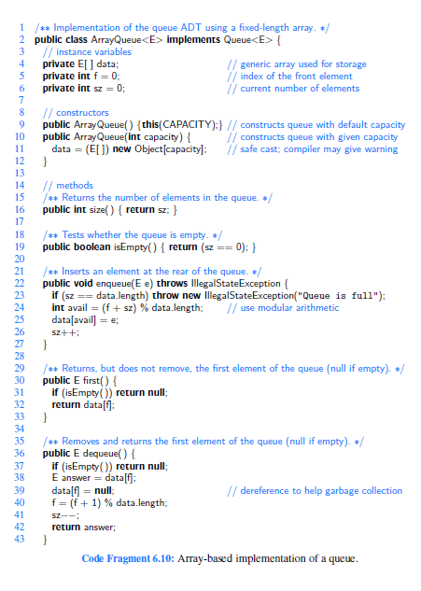

Slide 16
Chapter 6: Stacks, Queues, and Deques
R-6.8 Had the queue of the previous problem been an instance of the ArrayQueue class, from Code Fragment 6.10, with capacity 30 never exceeded, what would be the final value of the instance variable f?
F=10 (for all enq. F=0, at each deq, f will be incremented by 1 and we have 10 successful deq.)

Slide 17
Chapter 6: Stacks, Queues, and Deques
What happens if line 41 is removed in Code fragment 6.10?
What happens if line 26 is removed?

Slide 18
Chapter 8:Trees
R-8.1 The following questions refer to the tree of Figure 8.3.
Which node is the root?
What are the internal nodes?
How many descendants does node cs016/ have?
How many ancestors does node cs016/ have?
What are the siblings of node homeworks/?
Which nodes are in the subtree rooted at node projects/?
What is the depth of node papers/?
h. What is the height of the tree?

Slide 19
Chapter 8:Trees

Slide 20
Chapter 8:Trees
What is the pre-order, in-order and post-order traversals of the trees in Fig. 8.10, Fig 8.11.

Slide 21
Chapter 8:Trees

Slide 22
Chapter 8:Trees
R-8.22 Draw a binary tree T that simultaneously satisfies the following:
• Each internal node of T stores a single character.
• A preorder traversal of T yields EXAMFUN.
• An inorder traversal of T yields MAFXUEN.

Slide 23
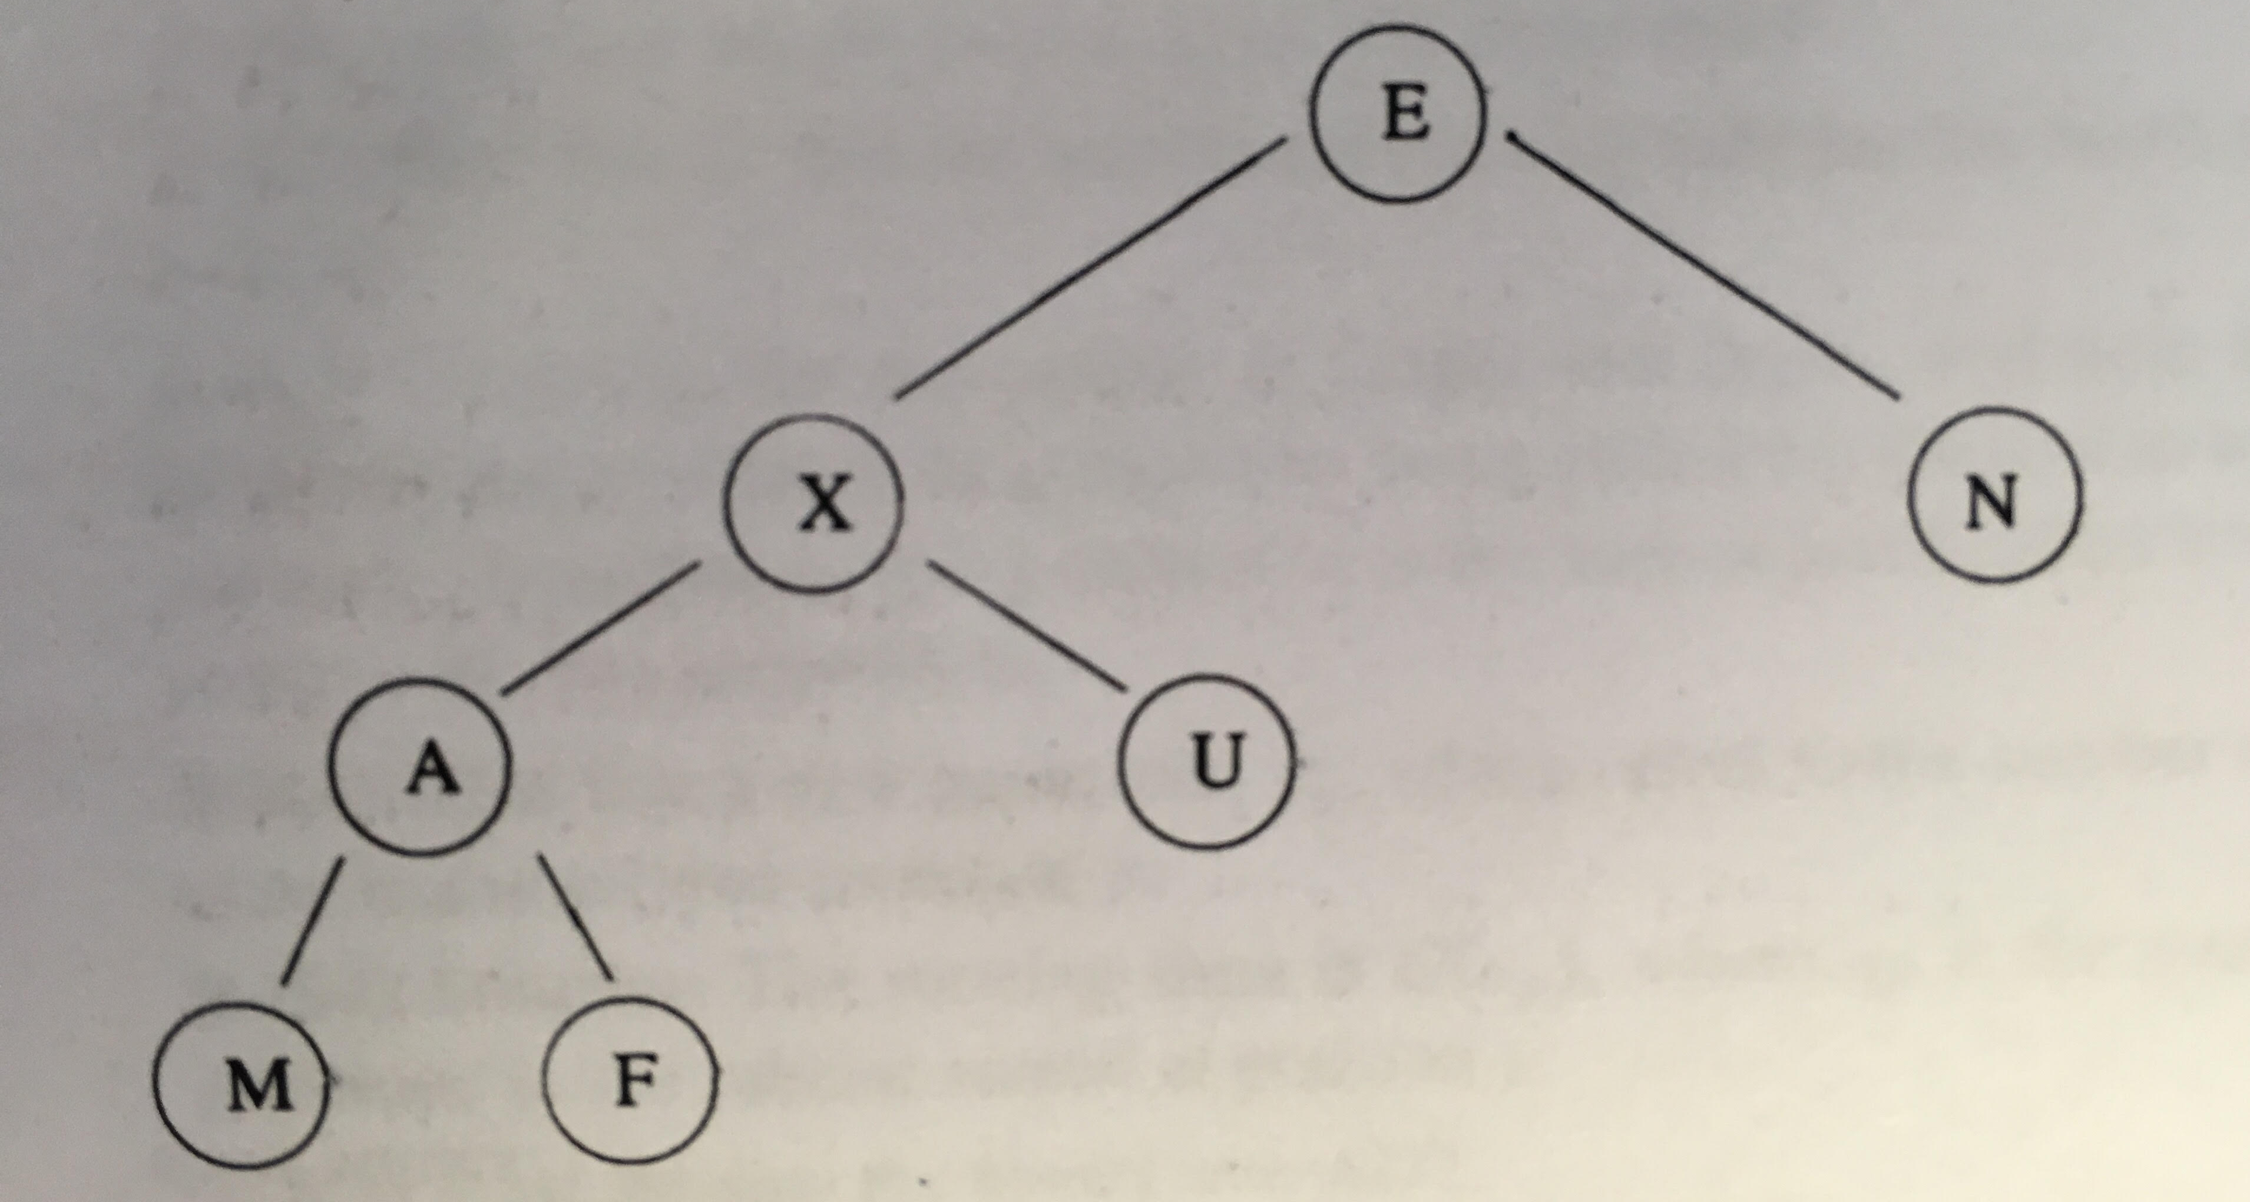
Chapter 8:Trees

